Slide 1
Scrapy: Common Patterns
Yi Sheng Siow

Slide 2
What is web scraping?
Notes:
Automation of a manual data collection process

Slide 3
7 Steps to easy scraping
Explore the data
List your columns
$ scrapy startproject [project name]
Paste a spider boilerplate
Get a POC running with the shell
Edit the spider
$ scrapy crawl [project name] -o data.csv/data.json -t json

Slide 4
Object model
Request
Response
- response.xpath(somequery) returns a Selector
- yield scrapy.Request(href, callback, errback) creates a Request
Selector
- selector.extract() and .extract_first() can return strings

Slide 5
Xpath
'//strong[@class="info"]/text()'
'//a[@itemprop="email"]/@href'
'//div[@class="exh-table-col exh-table-col--name"]/a/@href'
'//table//a/@href'
'//img[@data-attachment-id]/@src'
'(//strong)[1]/text()'
'//div[@class="article-content"]/p[last()]/text()'
'//span[@style="color: #ff0000;"]/descendant::*/text()'

Slide 6
Best Practices
Include column for URL scraped for manual checking/debugging
Include column for date scraped (where it makes sense)
If making many requests, rate limit yourself
Save the scraping log

Slide 7
Legality/Ethics/Common Sense
No legal advice
Purely for educational purpose
Common sense
  Scrape responsibly
  Rate-limit

Slide 8
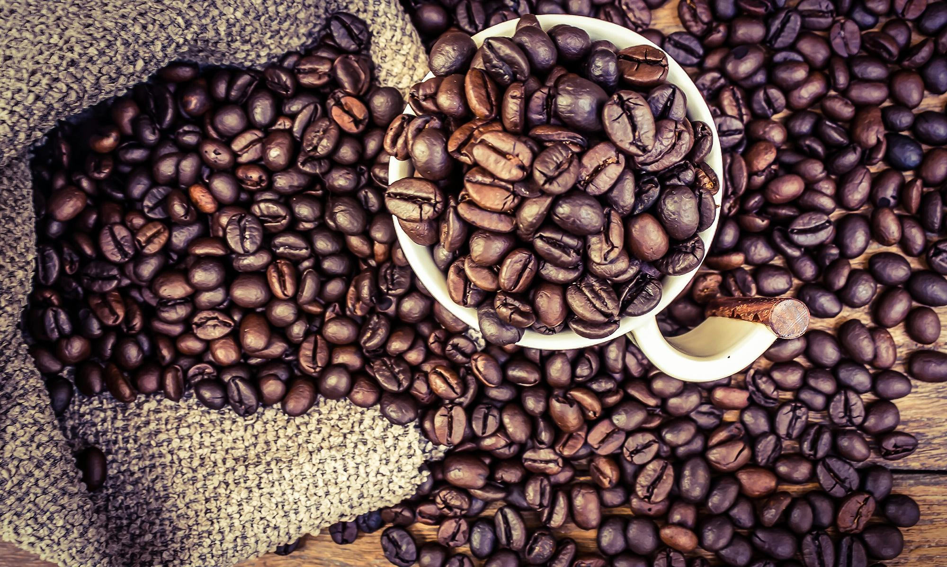
LOVE COFFEE?

Slide 9
1 link deep - Thailand Coffee
parse()
parse_company()

Slide 10

LOVE WINE?

Slide 11
Many start pages - Prowein
start_urls - multiple entries
parse()
parse_exhibitor_entry()

Slide 12

LOVE BOARD GAMES?

Slide 13
Images - Twilight Struggle
parse()
parse_card()
  urllib.request.urlretrieve(img_url, "images/{}.jpg".format(card_name))

Slide 14
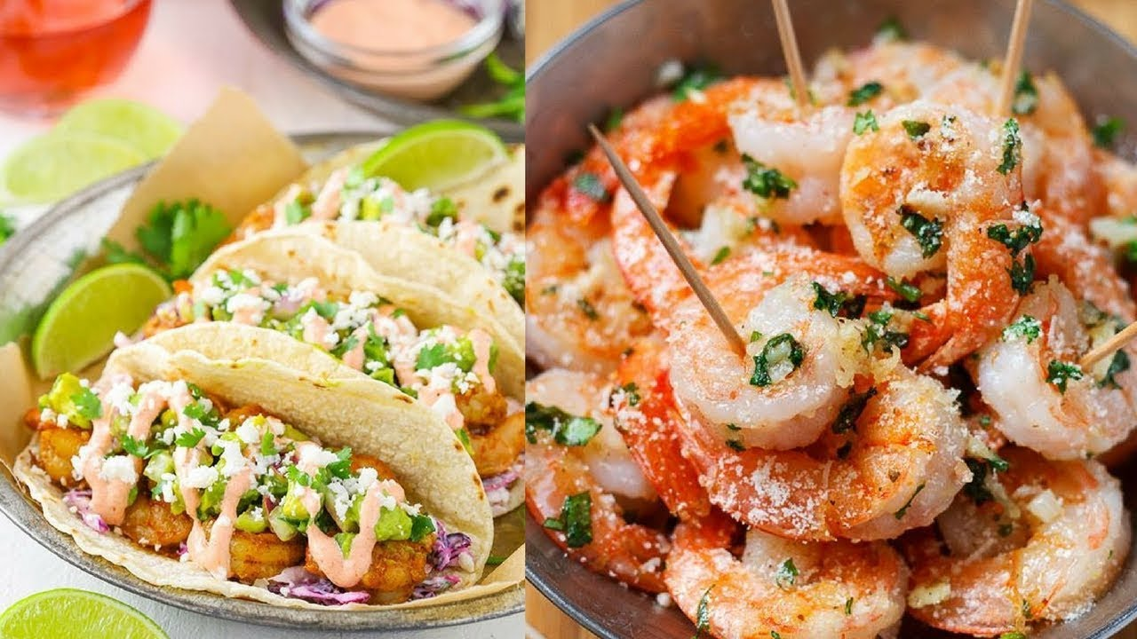
LOVE FOOD?

Slide 15
Pagination - ieatishootipost
parse()
  if next_page is not None:
    yield scrapy.Request(next_page)
parse_rname()

Slide 16

NEED A CONTRACTOR?

Slide 17
2 links deep + basic defense - Greenbook
parse()
  response.urljoin(href)
  meta to add big category info
parse_listing()
  meta to add small category info
parse_company()
  meta to add info onto decrypted email address

Slide 18
Questions
Notes:
Automation of a manual data collection process

